Slide 2
Channel mapping for the DREAM Mantel detector
version 0
PRESENTED BY IRina Stefanescu

Slide 3
The DREAM sample scattering system
Mantle detector
HR detector (TBD)
SANS tank +
Detector (TBD)
sample
beam
Forward detector (identical with the Backward detector)
Backward detector, “EndCap”
All 4 DREAM detectors will be delivered by the CDT company based in Heidelberg, Germany.
All 4 DREAM detectors will be B-10 based detectors. The mantle and EndCap detectors are from the Jalousie detector family, the design of the High Resolution and SANS detectors is still to be decided.

Slide 4
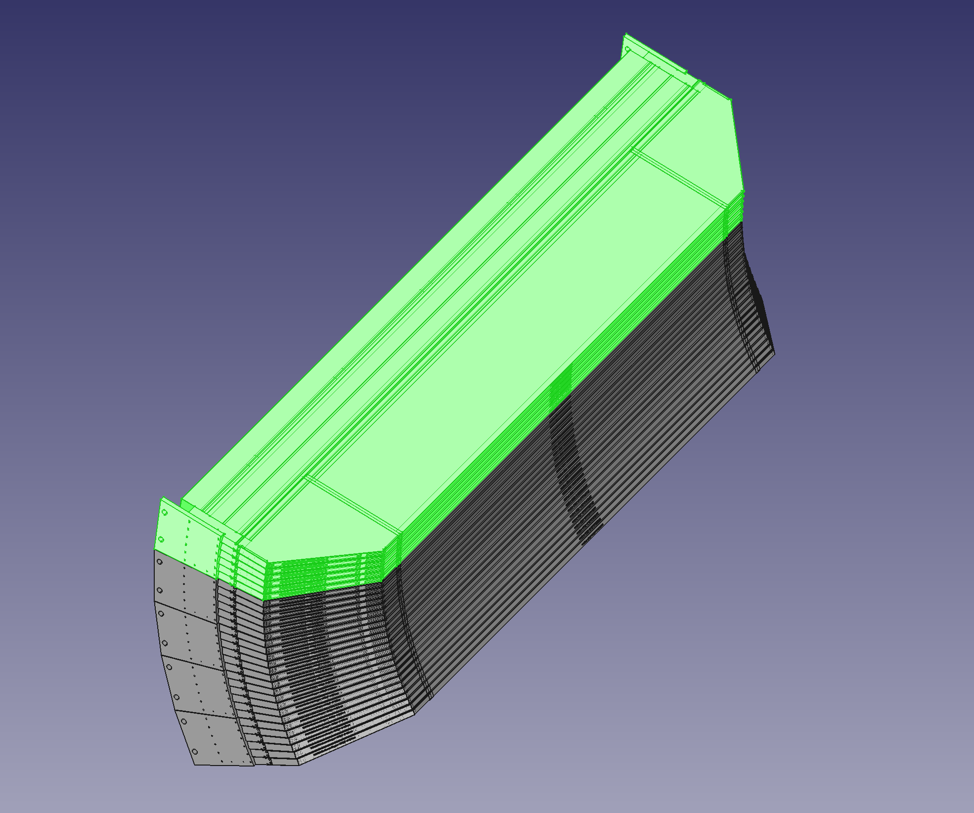
Mantel module = 6 segments
1 Mantel module = 6 cassettes
1 Mantel segment = 2 independent wire counter
(same as the EndCap cassette)
1 counter = 32 wires and 256 strips
beam

Slide 5
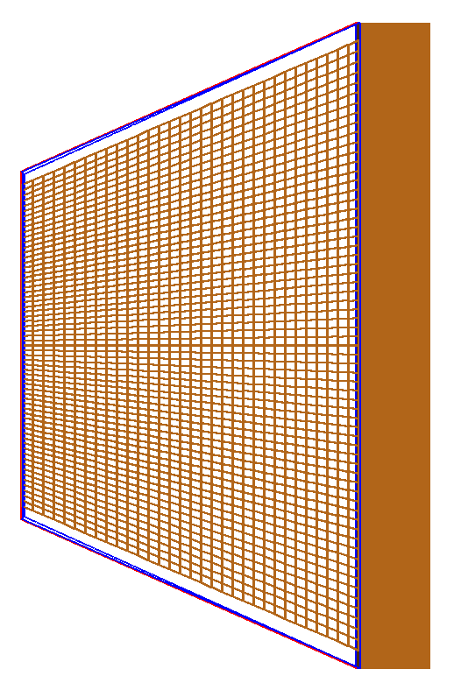
The Mantel detector employs the same detector concept as EndCap
φ
Anode wires
Beam axis
θ
View from above
Segmented cathode
Boron layers

Slide 6
sample
45°
Δθ=0.35°
n
1.1 m
However, unlike EndCap where the strips have equal size, in the Mantel detector the individual strips are designed to cover a equal solid angle Δθ=0.35° for a sample2detector detector of 1.1 m.
(irrelevant for channel mapping though)

Slide 7
The wires and the cathode strips are readout independently by 64-channels ASICs
Detectors for DREAM | No of segments per module | No of ASIC channels per segment | Total number of ASIC channels per Mantel module | Total number of voxels per Mantel segment
Mantel | 6 | 32 (w) + 256 (s) + 32 (w) | 6x320 = 1920 | 2*32*256 = 16 384
(w) – wire channel
(s) - strip channel

Slide 8
I very much assume that in the raw experimental data the location of a neutron event in the Mantel volume is given by 3 parameters, same as for the EndCap SUMOs:
boardID ➔ which SUMO recorded the hit
AnodeID ➔ which ASIC channel that reads out the wires fired
CathodeID ➔ which ASIC channel that reads out the cathode strips fired

Slide 9
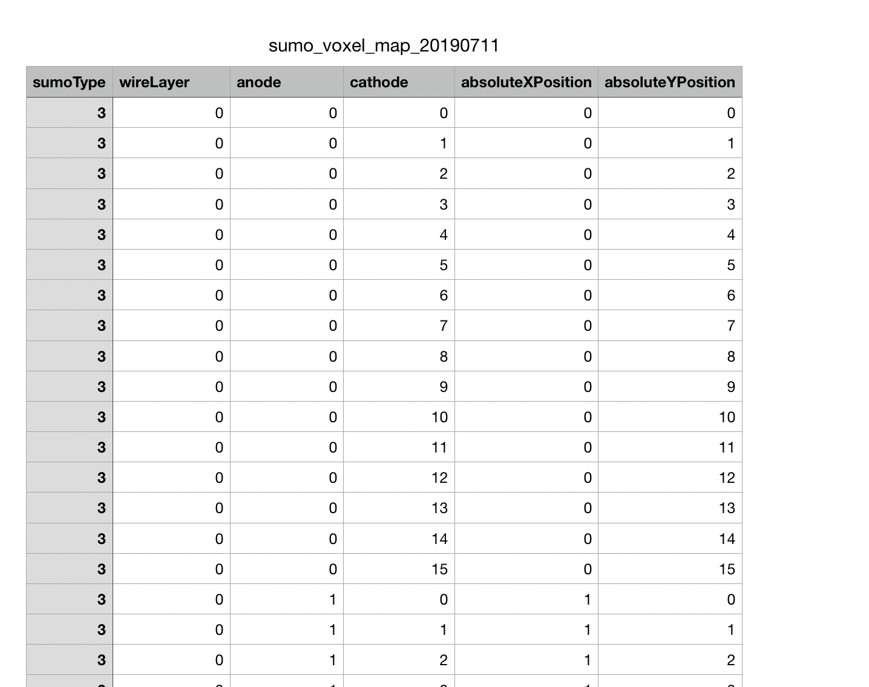
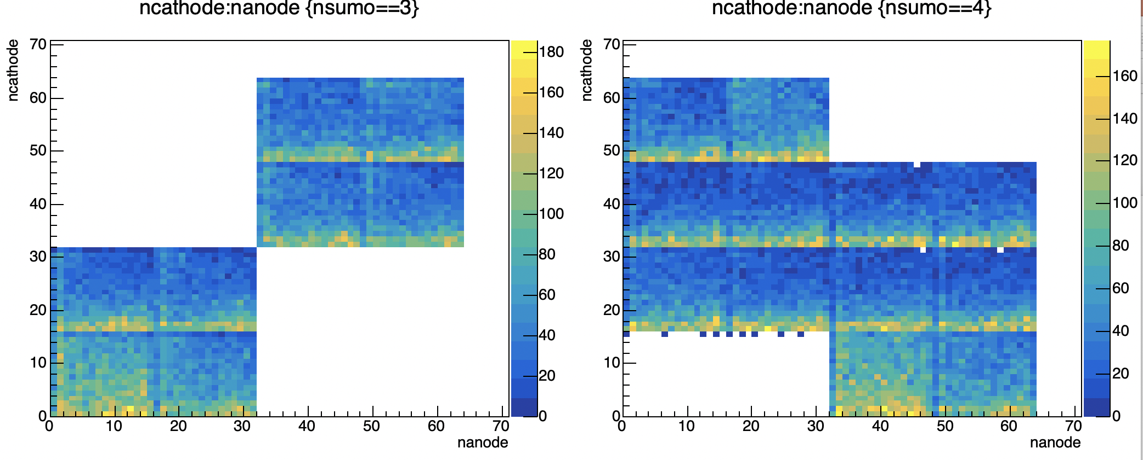
This kind of info is not available yet for Mantel, but I am trying to guess it, see next slide.
SUMO3
SUMO4
cathodeID
cathodeID
wl = 10
wl = 11
wl = 6
wl = 7
wl = 4
wl = 5
wl = 6
wl = 7
wl = 8
wl = 9
wl = 2
wl = 3
wl = 2
wl = 3
wl = 4
wl = 5
wl = 0
wl = 1
wl = 0
wl = 1
anodeID
anodeID

Slide 10
One Mantel cassette consists of 2x32 wire channels and 256 cathode strips channels. I assume that that the 256 strips are connected to four 64-channel ASICs and the 64 wires to fifth ASIC. Therefore the mapping could look like this for a Mantel module (6 cassettes):
Cassette 1
Cassette 2
Cassette 3
Cassette 4
Cassette 5
Cassette 6
255
Cathode ID (=ncathode)
wl=0
wl=1
wl=2
wl=3
wl=4
wl=5
wl=6
wl=7
wl=8
wl=9
wl=10
wl=11
0
31
63
94
…
…
…
…
…
…
…
…
191
Anode ID (=nanode)

Slide 11
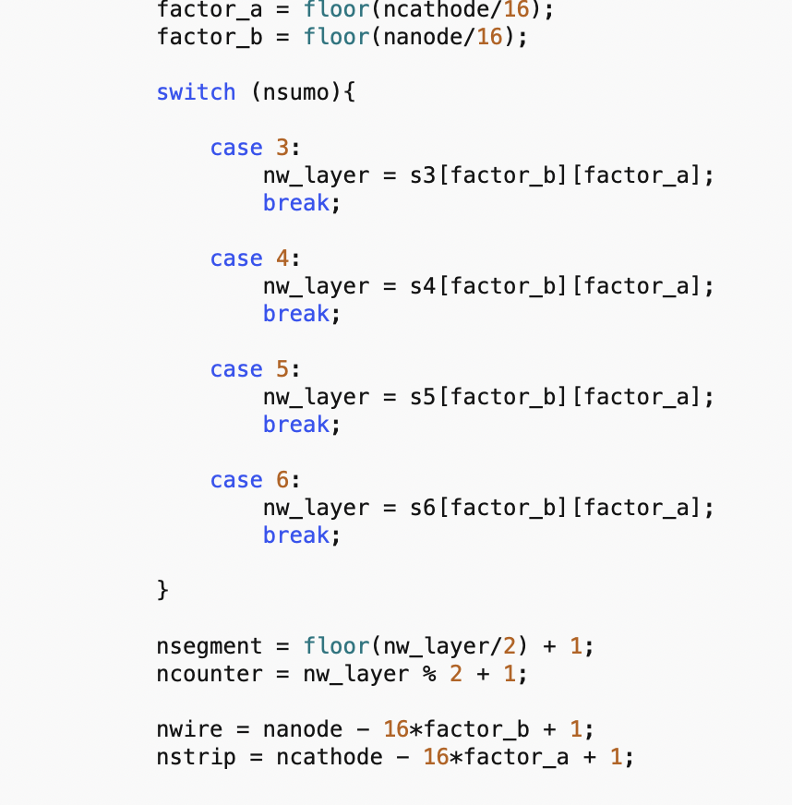
Best guess for Mantel based on the mapping scheme shown on the previous slide
SUMOs
nw_layer = [0,….,11]. (=wl)
For-loop through the neutron events
nsegment = floor(nw_layer/2) + 1;
ncounter = nw_layer % 2 + 1;
nwire = nanode – 32*nw_layer + 1;
nstrip = ncathode + 1;

Slide 12
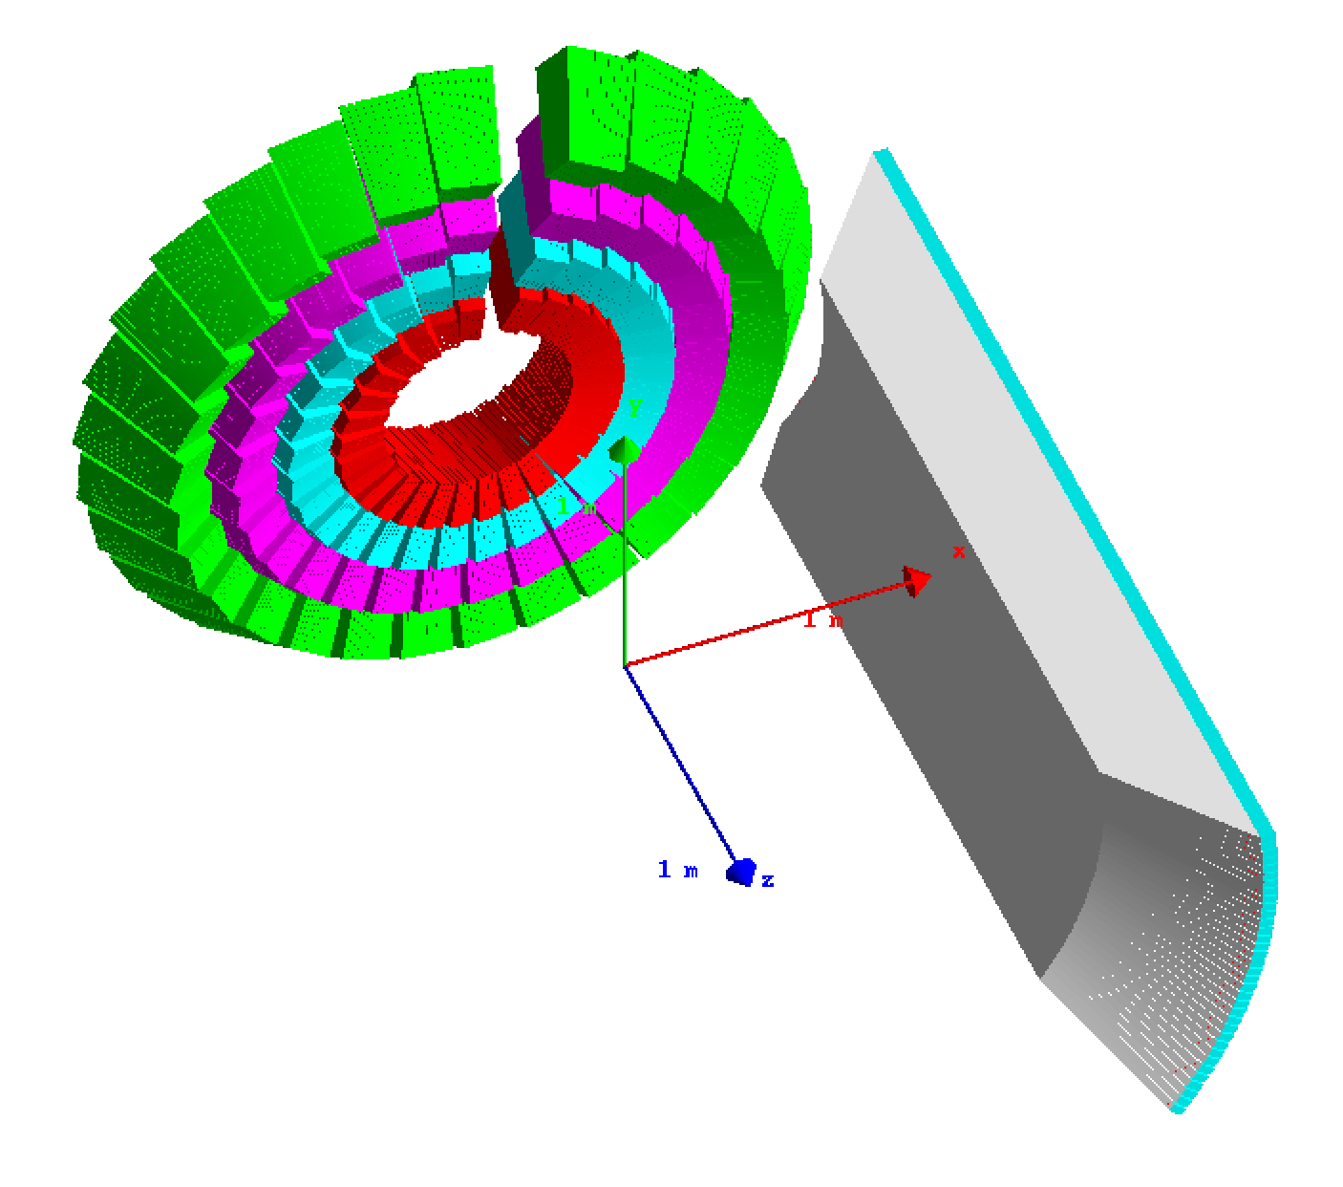
Strip 256
I also assume the following convention for wire/strip numbering
Strip 1
beam
Wire 1
Wire 32

Slide 13
Finish presentation

